Slide 1
Theory of Automata
Lecture # 3
Dr. Muhammad Fayaz

Slide 2
RECAP
Introduction to the course, Alphabets, Strings, Null string, Words, length of a string, Reverse of a string, Defining languages, Descriptive definition of languages, EQUAL, EVEN-EVEN, { a^{n} b^{n}}, { a^{n} b^{n} a^{n} }, SQUARE, DOUBLESQUARE, PALINDROME.
Regular Expression, etc. clear star closure, positive, etc.

Slide 3
Regular Expressions
Cont..

Slide 4
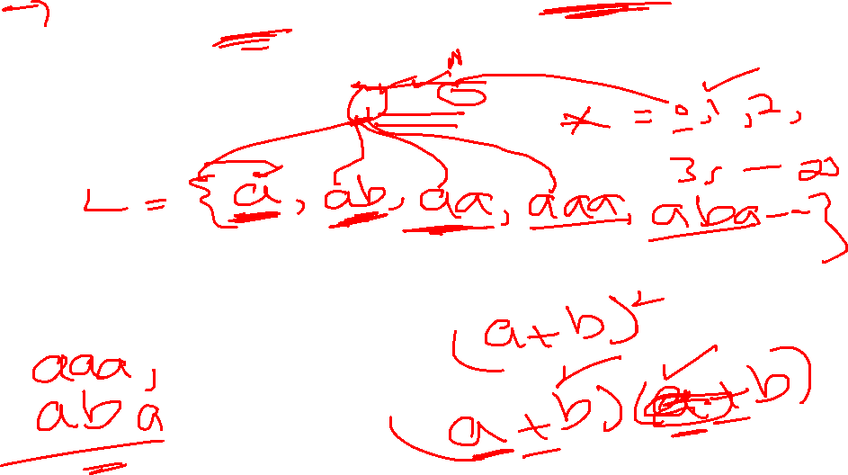
Example
Consider the language, defined over Σ={a, b} of words starting with a
Regular Expression = a(a + b)*

Slide 5
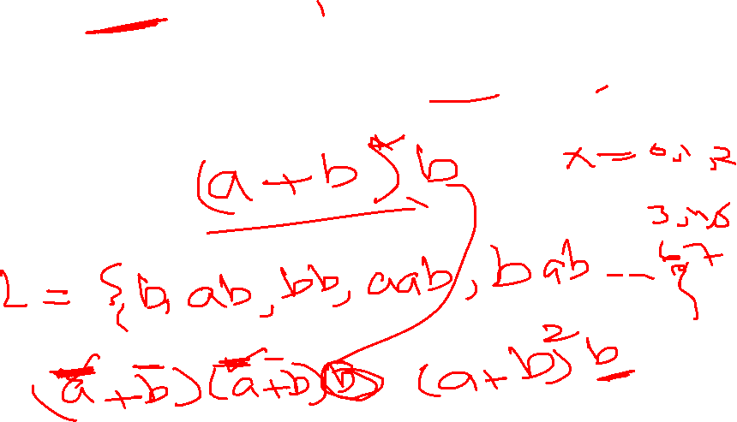
Example
Consider the language, defined over Σ={a, b} of words ending in b, then its regular expression may be
Regular Expression = (a + b)*b.

Slide 6
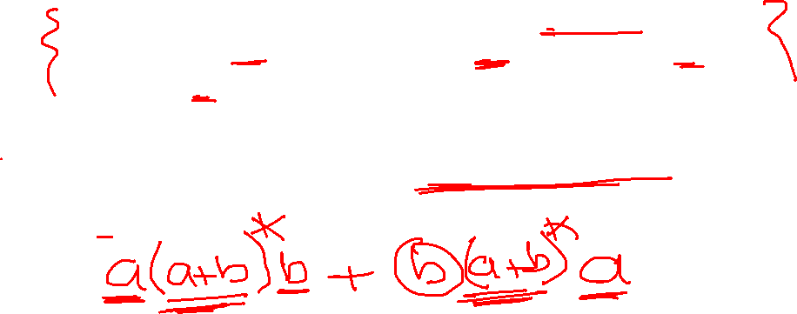
Example:
Consider the language, defined over Σ={a, b} of words starting with a and ending in b OR starting with b and ending in a, then its regular expression may be
Regular Expression= a(a+b)*b + b(a+b)*a

Slide 7
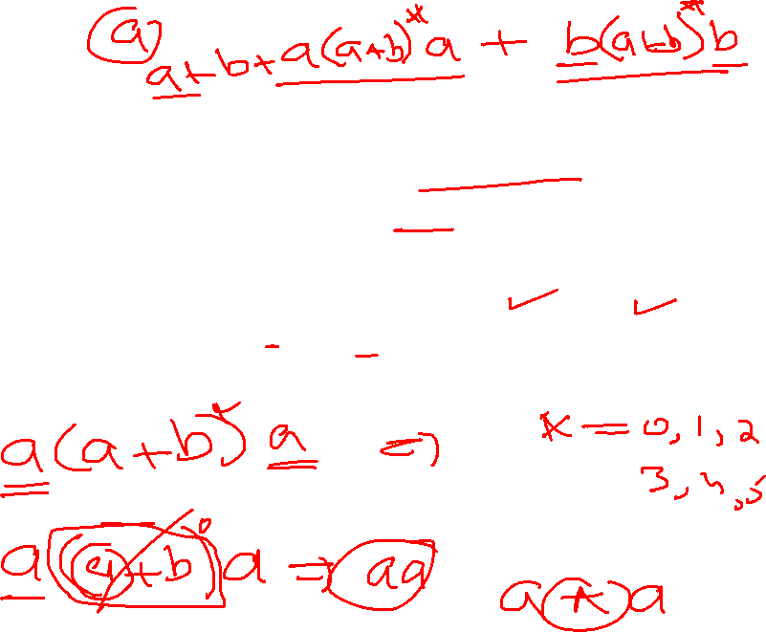
Example:
Consider the language, defined over Σ={a, b} of words beginning and ending in same letter, then its regular expression may be:
Regular Expression= (a + b)+a(a + b)*a + b(a + b)*b

Slide 8
Example:
Consider the language, defined over Σ={a, b} of words beginning and ending with different letter
Regular Expression= ?

Slide 9
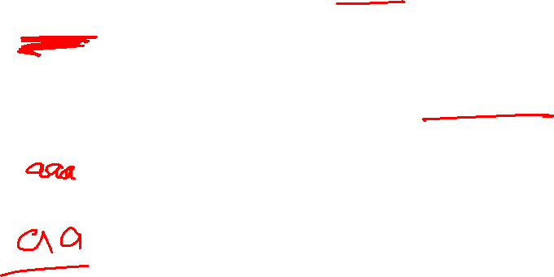
Example
Consider language L, of length 1, defined over Σ = {a, b}, then it’s regular expression may be
Regular Expression= (a + b)

Slide 10
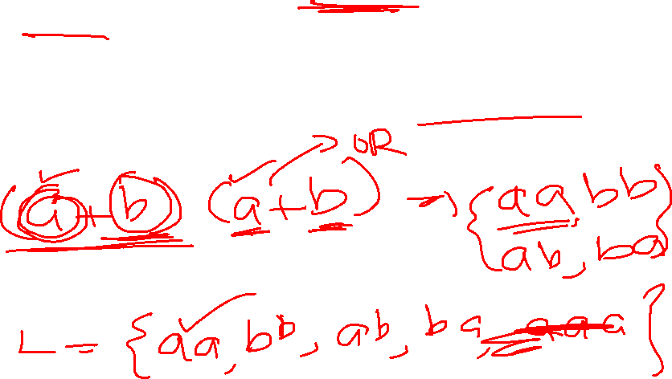
Example
Find the language L, of length 2, defined over Σ = {a, b}.
Regular Expression= (a + b)(a + b)

Slide 11
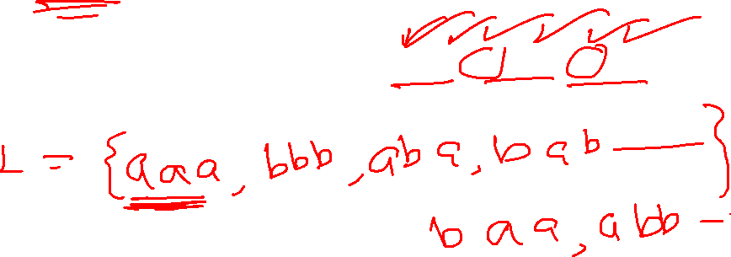
Example
Find the language L, of length 3, defined over Σ = {a, b}.
Regular Expression= (a + b)(a + b) (a +b)

Slide 12
Example for Practice
Find a language L, of length 3 staring with a, defined over Σ = {a, b}.
Regular Expression= ?

Slide 13
Example
Find the language L, of length 3 staring with a and ending with b, defined over Σ = {a, b}.
Regular Expression= ?

Slide 14
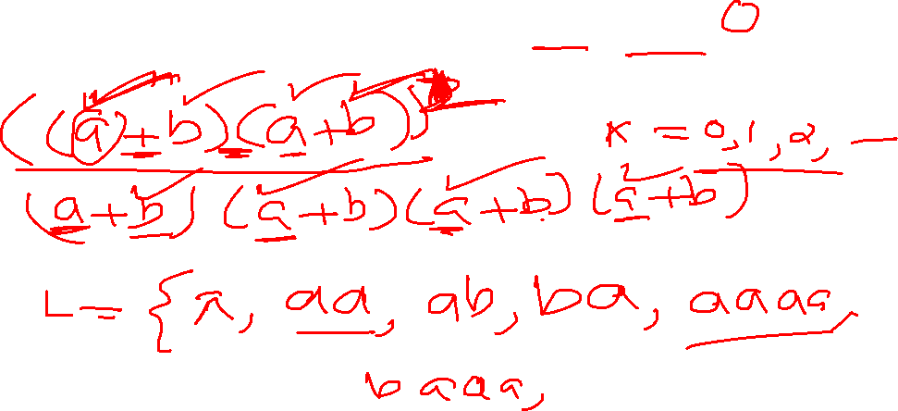
Example
Consider another language L, of even length, defined over Σ = {a, b}, then its regular expression may be:
Regular Expression= ((a + b)(a + b))*

Slide 15
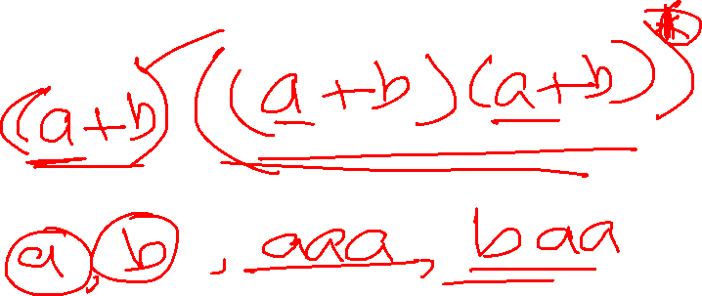
Example for Practice
Find the language L, of odd length, defined over Σ = {a, b}
Regular Expression= ?

